Slide 1
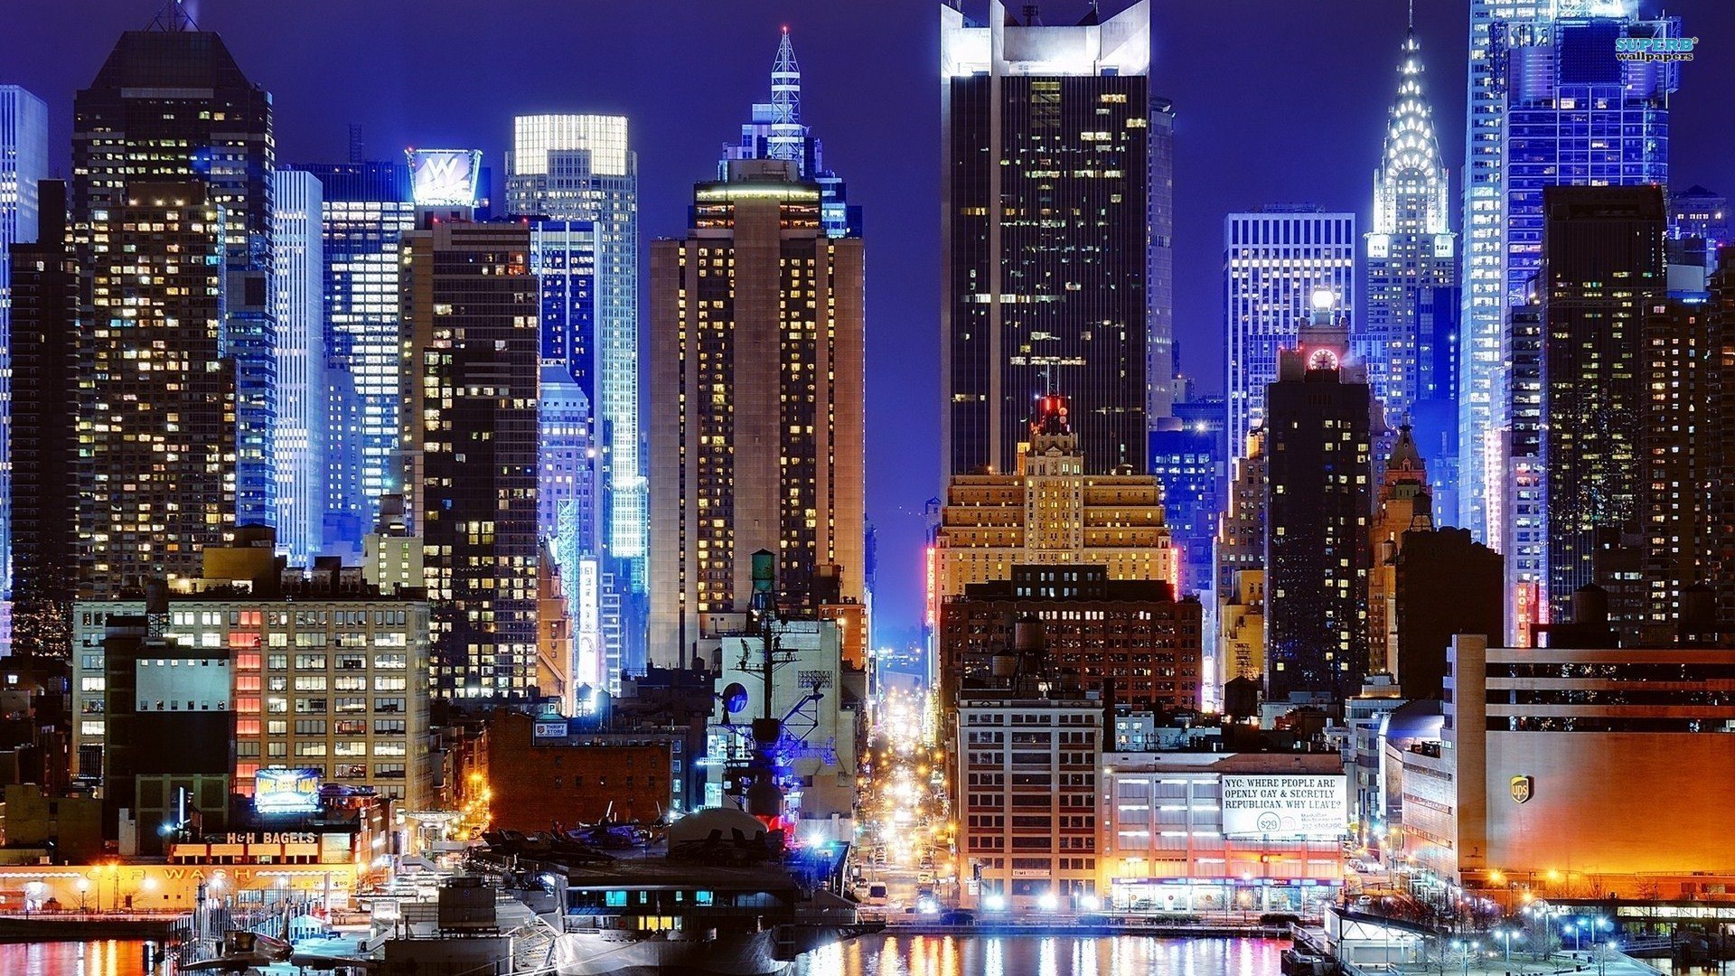

Slide 2
gala
“We Make a Difference”

Slide 3
Topics
Event marketing management
A broad view
Landing page
30 stories for 30 years
Marketable elements of the cocktail party
Social Media
Eblast
Location
Sponsorship Plan
Sponsorship Details
Save the date
Promotional campaigns
Invitations
Digital invitation
Journal
Post Event

Slide 4
Event Marketing Management
Digital Invitation
Landing Page
Email Blasts | in partnership with Kim
Social Media | Point to Landing Page | FB Event Creation
Save the Date Postcard
Participation Packages and Recruitment | Digital & Print (25)
Press Release | in partnership with Kim

Slide 5
Event Marketing Management
Kim receives all digital forms for tracking. CC Gloria for sponsors and supporters.

Slide 6
A Broad View
Black Tie Event!
What are other well known galas between July and January?
What is the end game goal - post gala
If this is the 30 year anniversary, do they have a clear vision on what the next 30 years is going have.
Who are you targeting as sponsors. Do you have a list of contacts.
Who are you targeting for ticket sales.
How will you make this event worth attending.
Do you have a database for invitations.
Who is being highlighted at the event – common thread

Slide 7
Landing Page Elements
Media Tab
Invitation
Link to register
Download of digital package
A description of event
Short summery of honorees
30 Stories for 30 years

Slide 8
30 Stories for 30 Years
Kim
Identify 20 – 30 stories that prove that AAMW has made a difference
Invite participation on save the date and on social media including eblast
Promotion
Landing Page
Email Blasts | Gloria graphics | Kim execution
Social Media | Point to Landing Page | FB Event Creation
Save the Date Postcard
Participation Packages and Recruitment | Digital & Print (25)

Slide 9
Marketable Elements of Cocktail Hour
Time
Who
Why

Slide 10
Social Media
Do we have YouTube
Do we have Instagram | Cater to next generation
Push FB page goal – 500 likes
Create event once images are ready
Share 30 stories
Share special registered guests with release (Dr’s, Lawyers, Executives, Politicians, teachers, folks that make a difference) and VIP announcements
Day of coverage | Live | Posts | Hashtag
Graphics provided by Gloria
Promotion Targets/ FB Demographics ____________________
Overall budget _____________________

Slide 11
Social Media
Special Dates
Good Friday Weekend: April 14 – 16
Mothers Day Weekend: May 12 – 14
Memorial Day Weekend: May 26 – 29
Acknowledgement of Fathers Day – Celebrate Men
Independence Day Weekend: July 1 – 4
Labor Day Weekend: Sept 2 – 4
Two weeks out
One week out

Slide 12
E- blast
Special Dates
Good Friday Weekend: April 14 – 16
Mothers Day Weekend: May 12 – 14
Memorial Day Weekend: May 26 – 29
Acknowledgement of Fathers Day – Celebrate Men
Independence Day Weekend: July 1 – 4
Labor Day Weekend: Sept 2 – 4
Two weeks out
One week out
Hashtag

Slide 13
Location
Marketing walk through
Entrance with event branding
Registration table
Give away bags on seat or to be given to each invitee
VIP Area – Step & Repeat

Slide 14
Sponsorship Plan
Graphics complete and final April 4
Physical full package send to print April 10 (provided by Gloria 25q)
Meetings start April 24
How many contacts do we have relationships with in order to peruse? 10 -15 | Standing relationships
Set apt, confirm meeting via email – send email with full package – arrive with full package.
Add potential sponsors to email mailing list – ask for biz cards
Fill form
Fax form to Gloria. Gloria to forward to Kim via email.
Gloria will contact to collect business details needed, discuss journal placement details

Slide 15
Sponsorship Details

Slide 16
Save the Date
April 3 – 6
Print 2K Save the date postcards 5x7 gloss. Round or square edges?
Mail to 500 contacts
Ask for a compelling and heartwarming story on how AAMW has made a difference. Direct them online. 30 stories will be selected for our website and final stories will appear in journal.
1500 cards left to be promoted where? Willing to market? Leverage events

Slide 17
Promotional Campaigns
Options
Church settings
Other friends
Fraternity groups
Lodge memberships
Change journal Ads
Photos of the Board (landing Page) / bottom ¼ Save The Date – Gala)
Promote at other events
Juneteenth | African American Festival | Other

Slide 18
Invitation
August - invitations go out as per Kim
Folded or Flat Invitation
Return labels
Gold envelop
RSVP Sponsorship details - white envelope
Direct to website for instant registration (business card or note on invitation)
Special thank you card to accompany invitation to those who have already committed to sponsorship.

Slide 19
Digital Invitation
April 10
Taken care by Kim
Eventbrite (fee)
Graphics and details provided by Gloria
Social Media and Eblast

Slide 20
Journal
Standard elements
Special elements – social responsibility report
How many of the 30 stories? Voted on?
Offer advertisers graphic design of their ad at an additional cost (included for sponsors)
Journal deadline November 1
Final approval November 3
Go to print November 6
Promote next event

Slide 21
Post Gala
Kim send eblast
Social Media share photos
Share photos

Slide 22
For Future Discussion
Promote your mission / On screen presentation Re. AAMW: Use marketing techniques to get your audience emotionally invested. Provide your audience a deeper understanding of your mission and vision through a visual presentation.
Game day signage: Your brand and your mission should shine on its special day. Signage includes photo backdrop, banners, two collage designs.

